Slide 1

REGULAR MEETING OF THE
ARKANSAS HIGHER EDUCATION
COORDINATING BOARD
April 26, 2024

Slide 2
AHECB Members
Graycen Bigger, Chair
Dr. Jerry Cash, Vice Chair
Dr. Kyle Miller, Secretary
Dr. Jim Carr
Dr. Katherine Dudley
Chad Hooten
Heather Maxey
Lucas Pointer
Carolyn Rhinehart

Slide 3
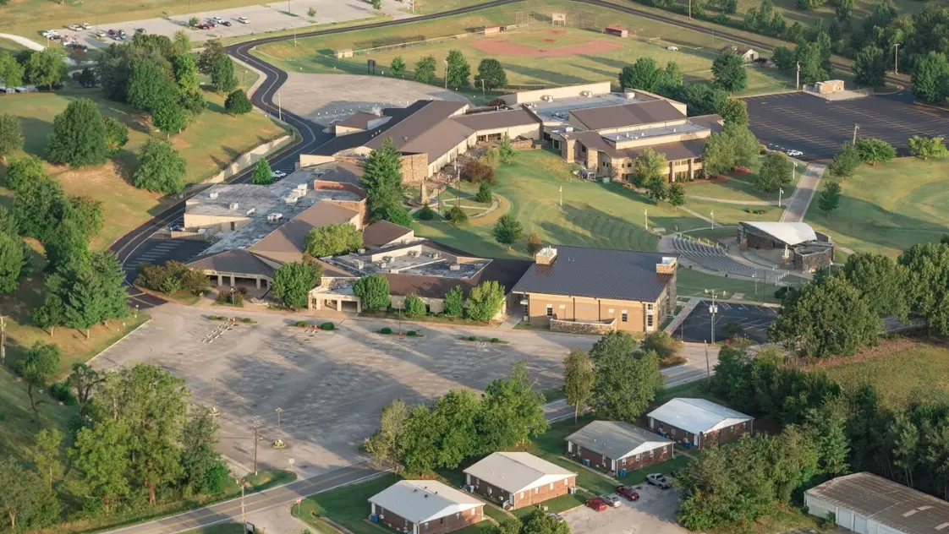
Dr. Rick Massengale, President
North Arkansas College

Slide 4
FINANCE COMMITTEE

Slide 5
Nick Fuller
Assistant Commissioner
AGENDA ITEM NO. 1:
DISTRIBUTION OF MINERAL LEASE FUNDS FOR 2023-2024

Slide 6
Distribution of Mineral Lease Funds
It is recommended that up to $475,000 be allocated (from the H.E. Research Development Fund) to the University of Arkansas, Fayetteville for continuing personal services and operating expenses associated with ARE-ON.
$13,466,058.59 has been distributed since May 2007, the first transfer of funds.
The current balance of the Research Development Fund is $255,858.59.

Slide 7
Nick Fuller
Assistant Commissioner
AGENDA ITEM NO. 2:
ECONOMIC FEASIBILITY OF A BOND ISSUE FOR THE
UNIVERSITY OF ARKANSAS AT FAYETTEVILLE

Slide 8
Relevant Information
$34.175 million with a term of up to thirty (30) years @ a rate of approximately 5.5%
Educational and General (E&G) purposes
Revenue Funding Source: Tuition and Fee Revenue

Slide 9
Relevant Information
Proceeds from the bond issue will be used for:
  The renovation, acquisition, construction, furnishing, and equipping of the Health, Physical Education, and Recreation Building;
  The acquisition of property for expansion purposes and other purposes of the Fayetteville Campus; and
  The acquisition, construction, improvement, renovation, equipping and/or furnishing of other capital improvements and infrastructure and the acquisition of various equipment and/or real property for the Fayetteville Campus.

Slide 10
Nick Fuller
Assistant Commissioner
AGENDA ITEM NO. 3:
ECONOMIC FEASIBILITY OF A BOND ISSUE FOR THE
UNIVERSITY OF ARKANSAS COMMUNITY COLLEGE AT MORRILTON

Slide 11
Relevant Information
$12.0 million with a term of thirty-two (32) years @ an estimated rate of 5.5%
Educational and General (E&G) purposes
Revenue Funding Source: Tuition and Fee Revenue

Slide 12
Relevant Information
Proceeds from the bond issue will be used for:
      The acquisition, construction, furnishing, and equipping of the Nursing and Science Center, and
      The acquisition, construction, improvement, renovation, equipping and/or furnishing of other capital improvements and infrastructure and the acquisition of various equipment and/or real property for UACCM.

Slide 13
Nick Fuller
Assistant Commissioner
AGENDA ITEM NO. 4:
ECONOMIC FEASIBILITY OF A BOND ISSUE FOR
ARKANSAS TECH UNIVERSITY

Slide 14
Relevant Information
$10.4 million with a term of up to fifteen (15) years @ a rate not to exceed 7.0%
Educational and General (E&G) purposes
Revenue Funding Source: Tuition and Fee Revenue

Slide 15
Relevant Information
Proceeds from the bond issue will be used for:
  The renovation of an educational building,
  Elevator replacement, and
  HVAC infrastructure in ten (10) of our buildings on the Russellville campus

Slide 16
ANY QUESTIONS?

Slide 17
ACADEMIC COMMITTEE

Slide 18
Mason Campbell
Assistant Commissioner
of Academic Affairs

Slide 19

New Program
Associate of Applied Science in Radiologic Technology
Academic Affairs Agenda Item No. 6

Slide 20

New Program
Associate of Applied Science in Nursing
Academic Affairs Agenda Item No. 7

Slide 21
Tracy Harrell
Chief Program Development Officer
Academic Affairs

Slide 22
Arkansas Public Letters of Notification
17 Arkansas public institutions submitted Letters of Notification
affecting 81 unique programs of study
Received by February 1, 2024
n | Requested Action
5 | CIP Change
34 | Curriculum Revision
1 | Deletion of Off-Campus Site
2 | Deletion of Option, Concentration, Emphasis, or Minor
1 | Existing Program Offered at Off-Campus Location
5 | Existing Program Offered Via Distance Education
2 | New Administrative Unit
14 | New Certificate
6 | New Option, Concentration, Emphasis, or Minor
5 | Program Deletion
1 | Program Inactivation
6 | Program Reconfiguration
2 | Title Change
84
Academic Affairs Agenda Item No. 8

Slide 23
Arkansas Public Letters of Intent
5 Arkansas public institutions submitted Letters of Intent
Received by April 1, 2024
n | Reason of Intent
8 | New Program
Academic Affairs Agenda Item No. 9

Slide 24
Alana Colburn
Associate Director of
Private Postsecondary Education

Slide 25
Out-of-State and Arkansas Private Institutions
New Programs
7 Institutions​​
24 Degree and Certificate Programs​​
​​
All programs meet the requirements of Arkansas ​law and AHECB policy
One New Institution: Alice L. Walton School of Medicine
Doctor of Medicine Degree Program
Academic Affairs Agenda Item No. 10

Slide 26
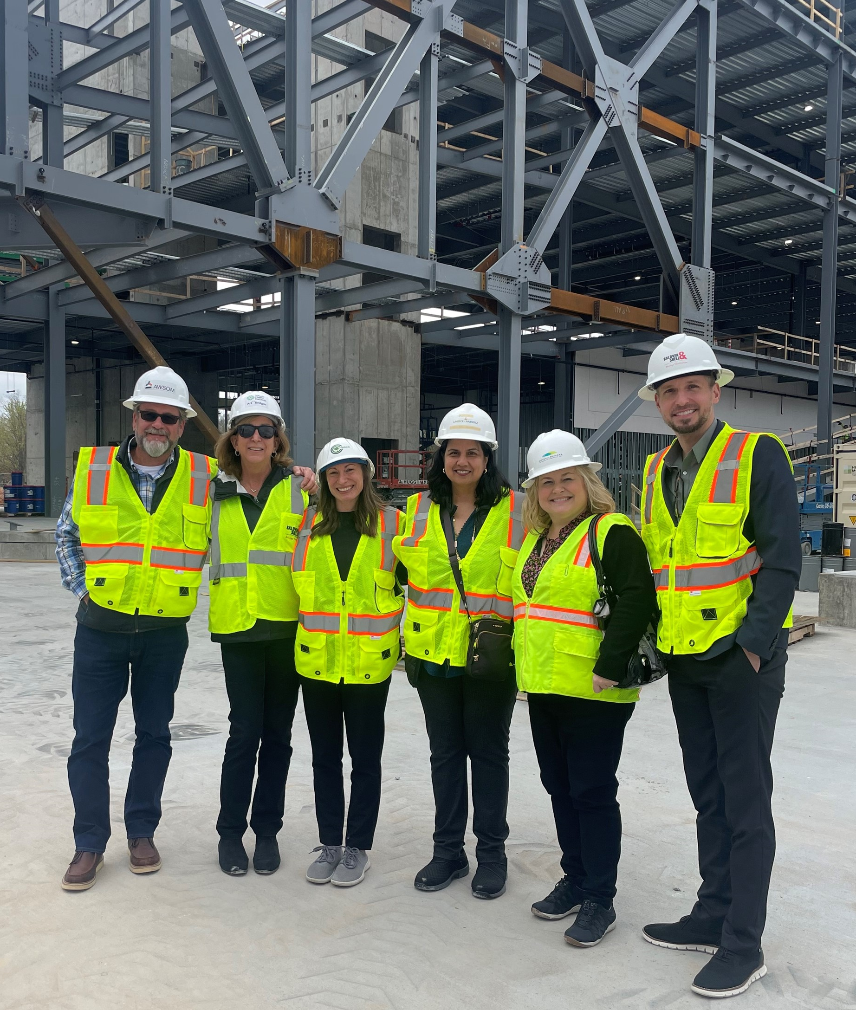
Alice L. Walton School of Medicine
Site Visit
Alice L. Walton School of Medicine and ADHE staff members at the future school site in Bentonville
Academic Affairs Agenda Item No. 10

Slide 27
Programmatic Accreditation
Candidate and Preliminary Status
School notifies of intent to seek accreditation
August 2022
Applicant Status granted
September 2022
School conducts Self-Study #1, submits materials
July 2023
LCME reviews materials – grants Candidate Status
November 2023
Site Visit
June 2024
If sufficient progress has been determined –
Preliminary Status granted
Fall 2024
Pending Accreditation Students begin
Fall 2025
Planning for Provision Accreditation in 2027
Planning for Full Accreditation in 2030

Slide 28
Institutional Accreditation
Preliminary Eligibility and Eligibility Status
School notifies intent to seek accreditation and submits Preliminary Evidence
March 2023
AWSOM Hosts Preliminary Evidence Interview
May 2023
Receive Post-Interview letter approving ability to seek Eligibility
July 2023
Submit Eligibility Filing
2025
Pending Accreditation Students begin
Fall 2025
Planning for Candidacy Status 2027
Planning for Full Accreditation 2030

Slide 29
Current Clinical Affiliates
ARISA
Children’s Hospital Northwest
Community Clinic
Highlands Oncology Group
Mercy Health Northwest Arkansas
Springwoods Behavioral Health
UAMS
VA Fayetteville
Washington Regional Medical Center

Slide 30
Memorandum of Understanding with UAMS
Faculty recruitment, development and retention
Alignment of clinical training objectives
Research support

Slide 31
Out-of-State and Arkansas Private Institutions
Letters of Notification
8 Out-of-State and Arkansas Private Institutions requested recertification of previously authorized programs
3 Institutions offering church-related training requested letters of exemption
5 Out-of-State and Arkansas Private Institutions submitted Letters of Notification for minor changes in authorized programs
Academic Affairs Agenda Item No. 11

Slide 32
Out-of-State and Arkansas Private Institutions
Letters of Intent
7 Out-of-State Institutions submitted Letters of Intent
Academic Affairs Agenda Item No. 12

Slide 33
ANY QUESTIONS?

Slide 34
REGULAR MEETING OF THE
ARKANSAS HIGHER EDUCATION
COORDINATING BOARD
April 26, 2024

Slide 35
Approval of Minutes
January 26 Regular Meeting

Slide 36
Dr. Ken Warden
Commissioner
AGENDA ITEM NO. 14:
COMMISSIONER’S REPORT

Slide 37


Institutional Changes
Dr. Wade Derden Named 5th President of National Park College, effective July 1, 2024.

Slide 38
LEARNS
High Demand & High Wage
State Distinction

Slide 39

Vision of a “Success Ready” Arkansas Graduate
“Success Ready” Arkansas Graduate:
On a path toward prosperity, with the knowledge, skills, abilities, and habits to be successful.
Enrollment - Enlistment - Employment
Graduation Requirements for All Students
Academic Core
Purposeful Courses Aligned to Postsecondary Plans
Community Service Demonstration
Student Success Plan
State Distinction
Accelerated Demonstration of Readiness Aligned to Choice of Success-Ready Pathway Course Sequence
Sequence of Three Courses
in an ADE Success-Ready Pathway
Assessment Aligned to Choice of ADE Success-Ready Pathway
Demonstration of Readiness
as Culmination of Pathway
Early Postsecondary Credit
Industry Recognized Credential
Work-based Learning
DISCUSSION-ONLY DRAFT
Notes:
Ross (intro)
HOPE, KIFFANY, MATT (Grad Req for all & Student Success Plans)
ROSS, TINA (State Distinction)
HOPE, KIFFANY, MATT (Grad Req for all & Student Success Plans)
The Vision of a “Success Ready” Arkansas Graduate is all encompassing for all students regardless of their plans after high school. If a student plans to enroll in a technical, two-year, or full college or university or enlist in the armed forces, or start employment, this process is for them all. The student success plan is the process by which the student can map out the plan for meeting the graduation requirements and develop a plan for purposeful coursework.

Slide 40
CTE Pathways
H2 Pathways
Accounting
Advanced Manufacturing
Agriculture, Power, Structural, and Technical Systems
Animal Systems
Automotive Service Technology
Banking
Business Finance
Computer Science-Programming
Computer Science-Networking
Construction
Criminal Justice
Management
Nursing Services
Plant Systems
Pre-Educator
Pre-Engineering
Retail Management
Welding
Notes:
HOPE, KIFFANY, MATT
Draft vision statement:
“Every Arkansas student deserves the opportunity to graduate “success-ready” on a path towards prosperity. In Arkansas, success-ready students are those who graduate K-12 education with the knowledge, skills, abilities, and habits to be successful on their chosen path, with options including enrollment in a postsecondary training or degree program, enlistment in military service, and employment in a career that provides a family-sustaining wage. Success-ready students are prepared to enter and complete postsecondary education without remediation and to seamlessly move into a career. To achieve these outcomes, students should have a clear understanding of their learning pathways from as early as middle school and obtain the academic and technical knowledge necessary to advance past entry-level positions, as well as demonstrate durable employability skills needed to be engaged citizens, positively contributing to their communities and the Arkansas economy.”

Slide 41
CTE Pathways
Additional Considerations for H2 List
  Regional justification based on industry demand
  Emerging industry
  Considerations other than wage or demand
Notes:
HOPE, KIFFANY, MATT
Draft vision statement:
“Every Arkansas student deserves the opportunity to graduate “success-ready” on a path towards prosperity. In Arkansas, success-ready students are those who graduate K-12 education with the knowledge, skills, abilities, and habits to be successful on their chosen path, with options including enrollment in a postsecondary training or degree program, enlistment in military service, and employment in a career that provides a family-sustaining wage. Success-ready students are prepared to enter and complete postsecondary education without remediation and to seamlessly move into a career. To achieve these outcomes, students should have a clear understanding of their learning pathways from as early as middle school and obtain the academic and technical knowledge necessary to advance past entry-level positions, as well as demonstrate durable employability skills needed to be engaged citizens, positively contributing to their communities and the Arkansas economy.”

Slide 42
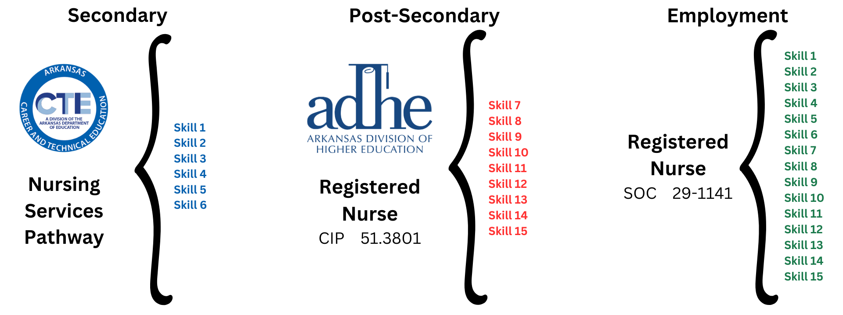
CTE Pathways
In many cases additional skills must be attained in a post-secondary setting before an individual is prepared for employment.
Notes:
HOPE, KIFFANY, MATT
Draft vision statement:
“Every Arkansas student deserves the opportunity to graduate “success-ready” on a path towards prosperity. In Arkansas, success-ready students are those who graduate K-12 education with the knowledge, skills, abilities, and habits to be successful on their chosen path, with options including enrollment in a postsecondary training or degree program, enlistment in military service, and employment in a career that provides a family-sustaining wage. Success-ready students are prepared to enter and complete postsecondary education without remediation and to seamlessly move into a career. To achieve these outcomes, students should have a clear understanding of their learning pathways from as early as middle school and obtain the academic and technical knowledge necessary to advance past entry-level positions, as well as demonstrate durable employability skills needed to be engaged citizens, positively contributing to their communities and the Arkansas economy.”

Slide 43
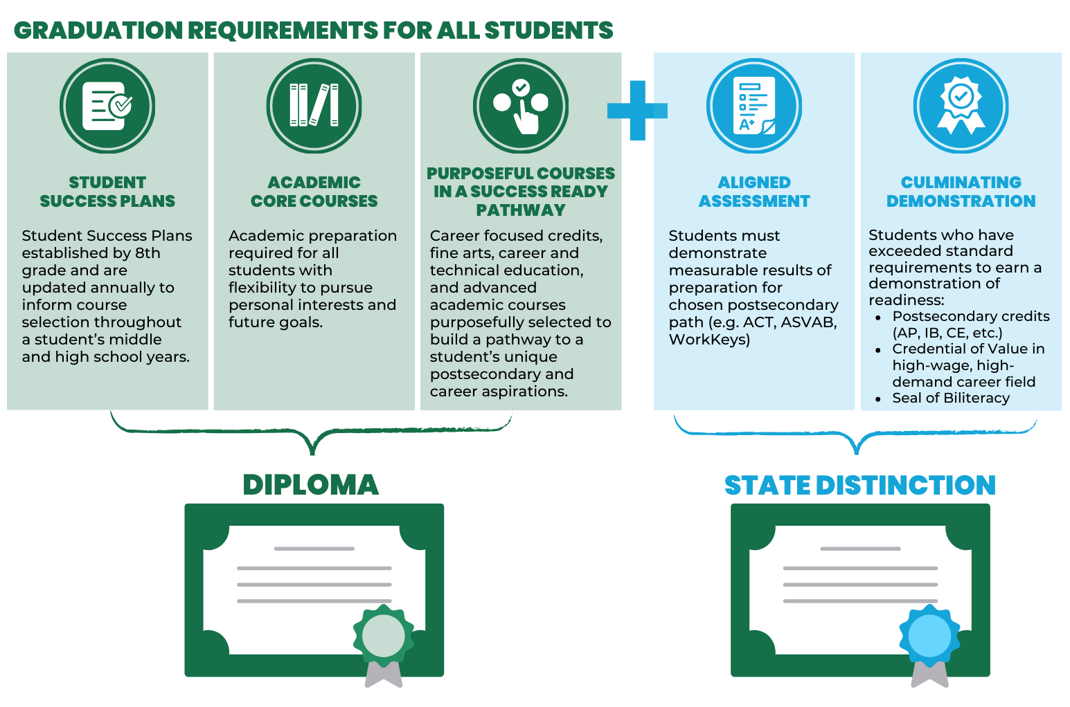
Career Ready Pathway to a Diploma
Diploma of Distinction
Notes:
HOPE, KIFFANY, MATT
Draft vision statement:
“Every Arkansas student deserves the opportunity to graduate “success-ready” on a path towards prosperity. In Arkansas, success-ready students are those who graduate K-12 education with the knowledge, skills, abilities, and habits to be successful on their chosen path, with options including enrollment in a postsecondary training or degree program, enlistment in military service, and employment in a career that provides a family-sustaining wage. Success-ready students are prepared to enter and complete postsecondary education without remediation and to seamlessly move into a career. To achieve these outcomes, students should have a clear understanding of their learning pathways from as early as middle school and obtain the academic and technical knowledge necessary to advance past entry-level positions, as well as demonstrate durable employability skills needed to be engaged citizens, positively contributing to their communities and the Arkansas economy.”

Slide 44
Additional Pathways to Distinction
Advanced Placement (AP)
Cambridge AICE
International Baccalaureate (IB)
World Languages-Seal of Biliteracy
12 Hours of Postsecondary Credit
Notes:
HOPE, KIFFANY, MATT
Draft vision statement:
“Every Arkansas student deserves the opportunity to graduate “success-ready” on a path towards prosperity. In Arkansas, success-ready students are those who graduate K-12 education with the knowledge, skills, abilities, and habits to be successful on their chosen path, with options including enrollment in a postsecondary training or degree program, enlistment in military service, and employment in a career that provides a family-sustaining wage. Success-ready students are prepared to enter and complete postsecondary education without remediation and to seamlessly move into a career. To achieve these outcomes, students should have a clear understanding of their learning pathways from as early as middle school and obtain the academic and technical knowledge necessary to advance past entry-level positions, as well as demonstrate durable employability skills needed to be engaged citizens, positively contributing to their communities and the Arkansas economy.”

Slide 45


Slide 46
Mason Campbell
Agenda Item No. 15
Annual Report on
First-Year Student Remediation
Assistant Commissioner of Academic Affairs

Slide 47
Report on First-Year Student Remediation
In accordance with A.C.A. §6-61-110 and Act 970 of 2009, the Arkansas Division of Higher Education (ADHE) addresses the placement standards necessary for enrollment of students into mathematics, English composition, and reading based on appropriate indicators of potential student success rates.
  Students who required remediation during their first year of enrollment in a public state-supported institution of higher education in this state if the enrollment occurred within two (2) years of graduation from a secondary school in this state.
  Students who require remediation and who graduated with a 3.0 or higher GPA.
  Number of attempts it takes a student to pass postsecondary remedial courses.

Slide 48
Report on First-Year Student Remediation
Total Population = 21,510

Slide 49
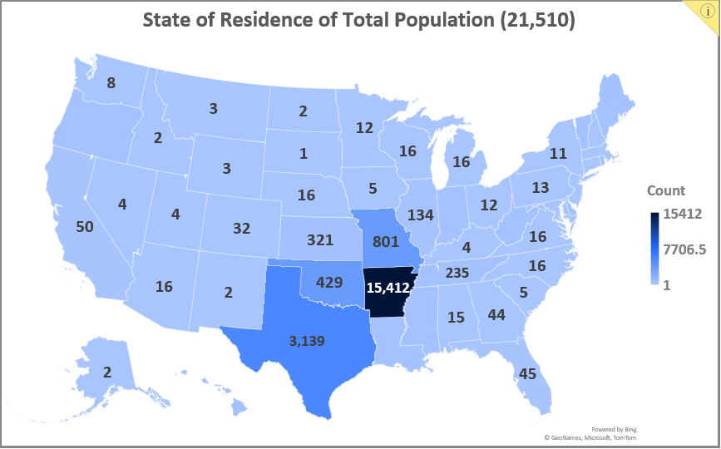
Report on First-Year Student Remediation
0
5
0
2
7
4
2
1
7
0
49
306

Slide 50
Report on First-Year Student Remediation
29 records from GPA ranges 0.0 – 1.499 are not depicted in this chart.

Slide 51
Report on First-Year Student Remediation
Remediation Population
= 8,106

Slide 52
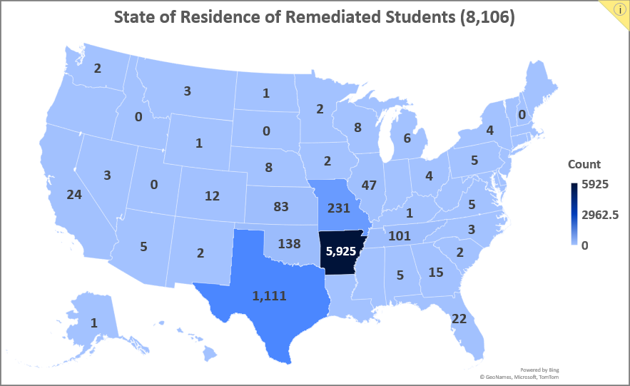
Report on First-Year Student Remediation
0
2
0
2
1
0
0
1
13
159

Slide 53
Report on First-Year Student Remediation
 | Total Population* (21,510) |  | Remediation Population (8,106) |  | Remediation Rate by Race/Ethnicity
 | n | Percentage | n | Percentage
American Indian | 166 | 1% | 60 | 1% | 36%
Asian | 435 | 2% | 142 | 2% | 33%
Black | 2,740 | 13% | 1,691 | 21% | 62%
Hispanic | 2,448 | 11% | 1,149 | 14% | 47%
Native Hawaiian | 45 | 0% | 15 | 0% | 33%
Non-US Resident | 292 | 1% | 153 | 2% | 52%
Two or more races | 1,023 | 5% | 396 | 5% | 39%
Unknown | 120 | 1% | 52 | 1% | 43%
White | 14,241 | 66% | 4,448 | 55% | 31%
Total | 21,510 | 100% | 8,106 | 100% | 38%
* Number of first-time, degree seeking students who graduated high school in 2022 or 2021.

Slide 54
Report on First-Year Student Remediation

Slide 55
Report on First-Year Student Remediation

Slide 56
Report on First-Year Student Remediation
31 institutions offered corequisite remediation
20 institutions offered gateway remediation
18 offered non-gateway remediation in mathematics

Slide 57
Report on First-Year Student Remediation
5,446 students who required remediation graduated high school with a GPA of 3.0 or higher
10 records from GPA ranges 0.0 – 1.499 are not depicted in this chart.

Slide 58
Report on First-Year Student Remediation

Slide 59
Report on First-Year Student Remediation

Slide 60
Report on First-Year Student Remediation
Number of attempts it takes a student to pass postsecondary remedial courses
Attempts | Percentage
Once | 92.1%
Twice | 6.5%
Three or more | 1.5%

Slide 61
Report on First-Year Student Remediation
Appendix B shows gateway course success rates for each institution by subject area for remediated students. These students took both remedial and gateway courses during AY2023, or as a concurrent student, and passed with an A, B, C, CR, P, or S.
Institution | Subject | Failed | Passed | Total | Success Rate
EACC | Math | 5 | 13 | 18 | 72.2%
 | English | 8 | 24 | 32 | 75.0%
 | Reading | 8 | 24 | 32 | 75.0%
Institution | Subject | Failed | Passed | Total | Success Rate
UALR | Math | 55 | 134 | 189 | 70.9%
 | English | 10 | 86 | 96 | 89.6%
 | Reading | 10 | 85 | 95 | 89.5%
Based on the 21,510 AY2023 first-time entering, degree seeking students who graduated high school in 2022 or 2021.
Course subjects identified by AHEIS Credit Course File CIP Code fields.

Slide 62
Report on First-Year Student Remediation
Appendix C shows the college, remedial, and overall success rates of the first math course completed at each institution and offers insight into the effectiveness of an institution’s placement plan. Placement measures should reflect a better than 75% student success rate.
Institution | Placement Course Level | Failed | Passed | Total | Placement Success Rate
ANC | College | 25 | 83 | 108 | 76.9%
 | Remedial | 9 | 42 | 51 | 82.4%
 | Overall | 34 | 125 | 159 | 78.6%
Institution | Placement Course Level | Failed | Passed | Total | Placement Success Rate
UAFS | College | 46 | 322 | 368 | 87.5%
 | Remedial | 76 | 278 | 354 | 78.5%
 | Overall | 122 | 600 | 722 | 83.1%
Based on the 21,510 AY2023 first-time entering, degree seeking students who graduated high school in 2022 or 2021.

Slide 63
Questions?

Slide 64
AHECB Meeting
April 26, 2024
Annual Report of
Student Retention and Graduation
Sonia Hazelwood, Assistant Commissioner
Information Systems & Technology Innovation

Slide 65
National Center for Education Statistics (NCES)
National Retention Rates
According to the most recent data published in May 2023 in the Report on the Condition of Education 2023, NCES reported 81% of the first-time, full-time degree-seeking students who enrolled at a 4-year degree-granting institution in fall 2020 returned in the fall 2021.
Students who enrolled at a 2-year college in fall 2020 and then returned in fall 2021 or completed their program within the year, reported a 61% retention rate.

Slide 66
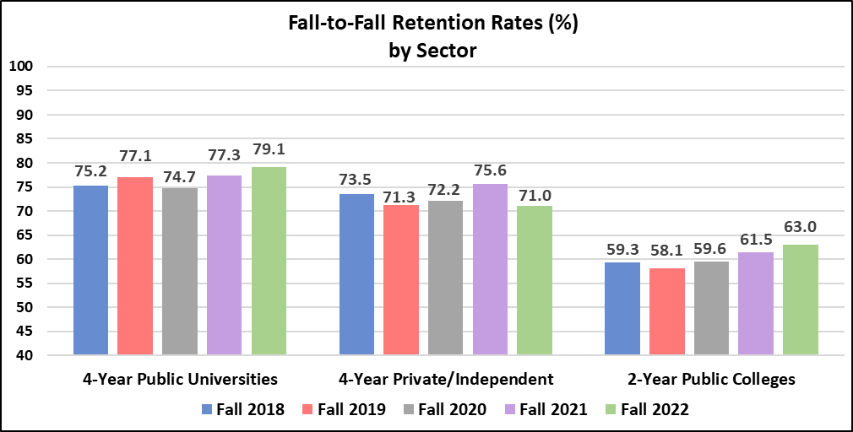
Statewide Retention
The retention calculations for the 4-year institutions are based on students in the IPEDS cohort of fall term, first-time entering, full-time, and bachelor-seeking students returning to your institution the next fall term.
Retention rates for our 2-year colleges follows the IPEDS model and includes students receiving any certificates during the year.

Slide 67
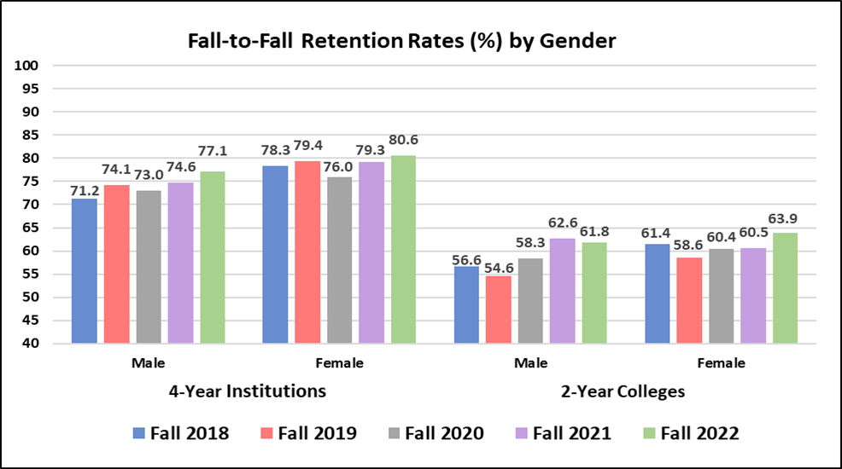
Retention – Public Institutions
Both male and female cohorts showed improved retention rates for our public 4-year institutions.
For our 2-year colleges, the female cohort reported an increase over 3% while the male cohort reported a modest decline.
Notes:
Public and private Institutional charts are provided in the board book.

Slide 68
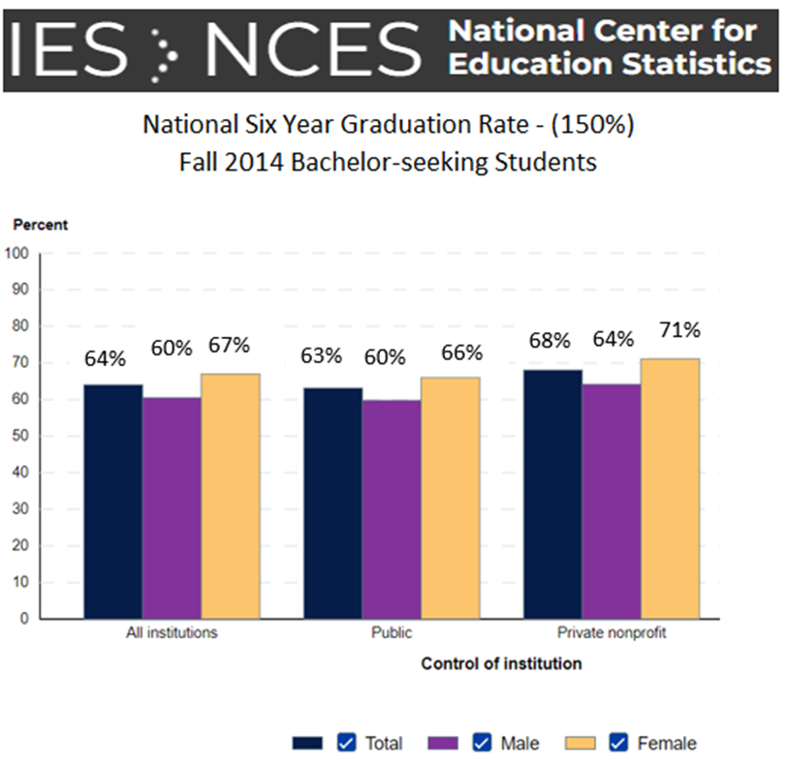
National Center for Education Statistics (NCES)
National Graduation Rates
https://nces.ed.gov/programs/coe/indicator/ctr

Slide 69
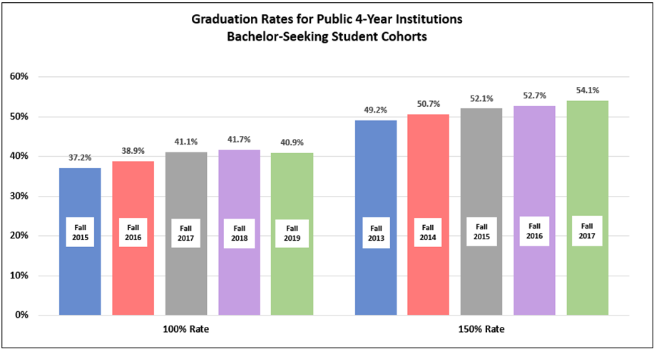
4-Year Public Graduation Rates
For the 4-Year public institutions, there was a slight dip in the 100% graduation rate, but the 150% graduation rate increased 1.4%.

Slide 70
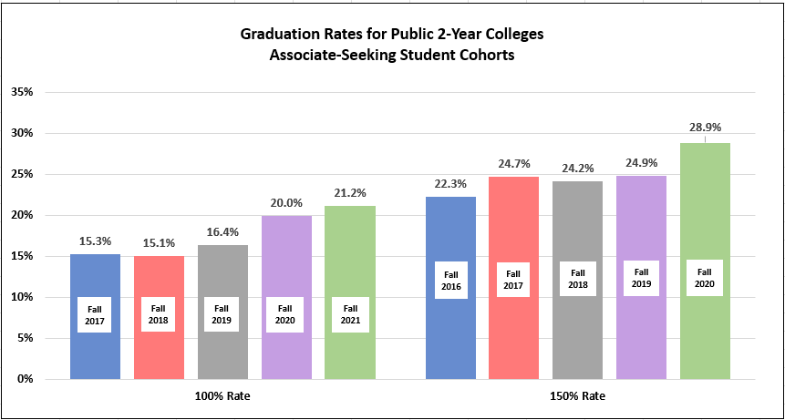
2-Year Public Graduation Rates
For the 2-Year colleges, there was an increase in both the 100% graduation rate and the 150% graduation rate. Most notably, an unusual 4% increase in the 150% graduation rate.

Slide 71
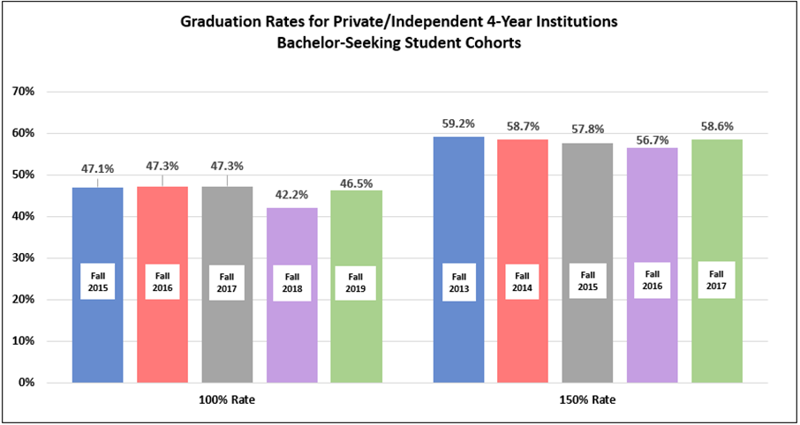
4-Year Private/Independent Graduation Rates
For the 4-Year private institutions, there was an increase in both the 100% graduation rate and the 150% graduation rate.

Slide 72
AHECB Meeting
April 26, 2024
Annual Report of
Student Retention and Graduation of Student-Athletes
Sonia Hazelwood, Assistant Commissioner
Information Systems & Technology Innovation

Slide 73
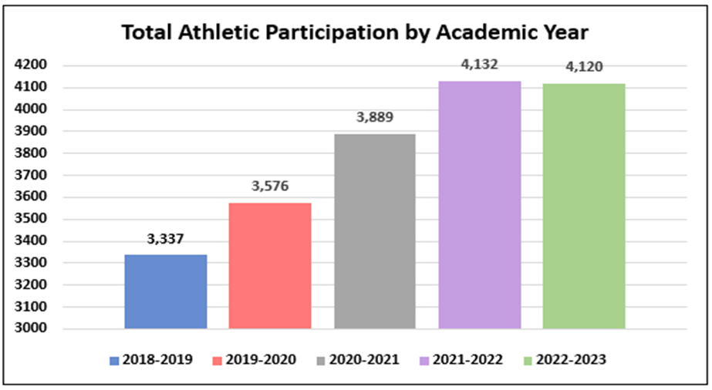
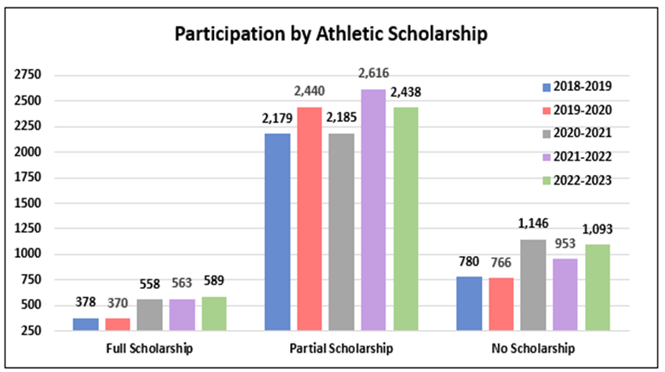
Student-Athlete Participation
and Scholarship Type
Athletic participation barely declined for the 2022-23 academic year with over 4,100 students participating in over 15 sports.
Athletes receiving full athletic scholarship or no athletic scholarship both increased, while the number of student-athletes receiving a partial scholarship declined for 2022-23.

Slide 74
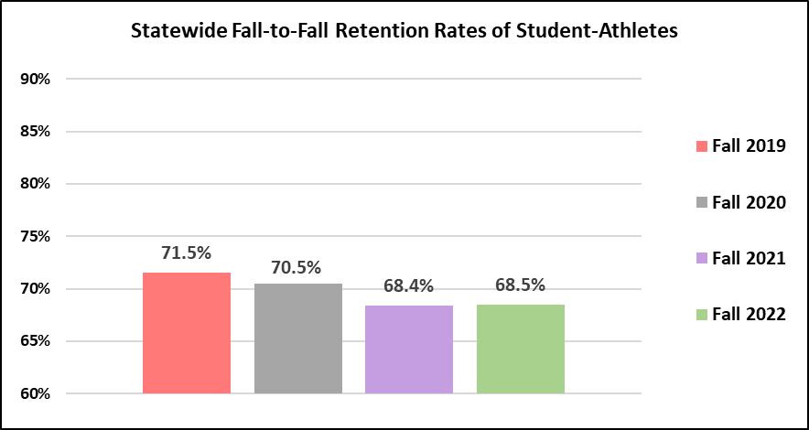
Student-Athlete Retention
The retention rate for our student-athletes remained consistent at 68% for the Fall 2022 first-time entering student-athletes returning in the Fall 2023.

Slide 75
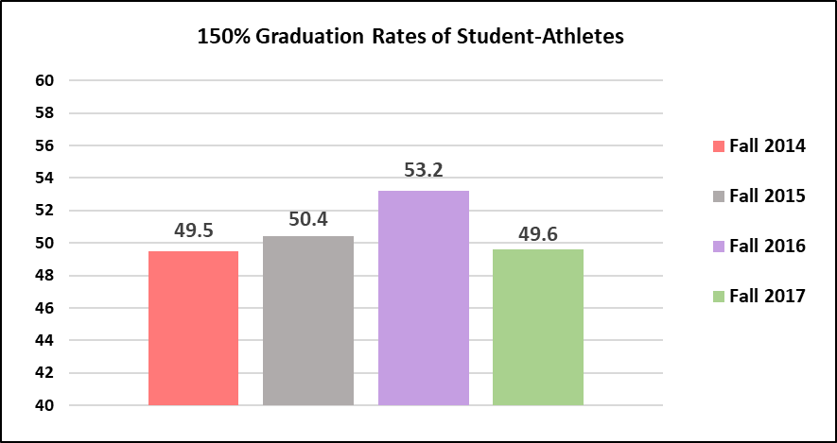
Student-Athlete Graduation Rates
The student-athlete graduation rate remains consistently around 50% except for the Fall 2016 cohort, which reported a higher graduation rate of 53.2%.

Slide 76
Alisha Lewis
Assistant Commissioner for Operations
AGENDA ITEM NO. 18:
Request for ARHEG Slot Fee Increase

Slide 77


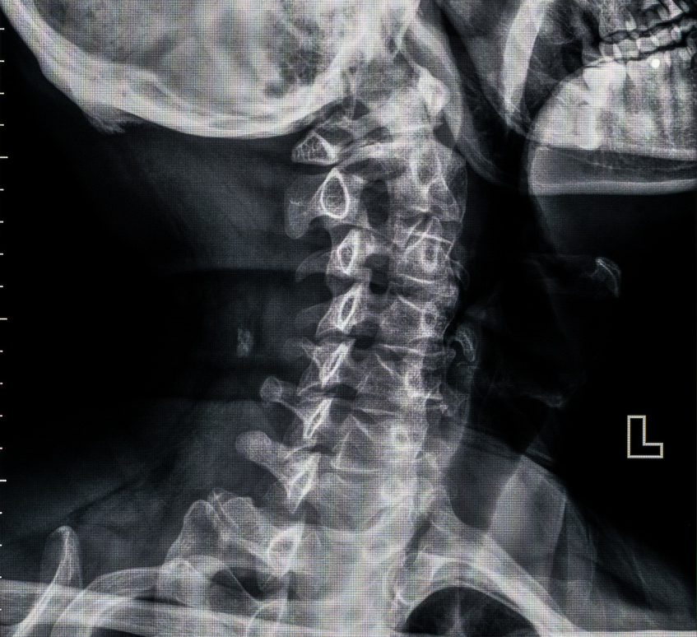


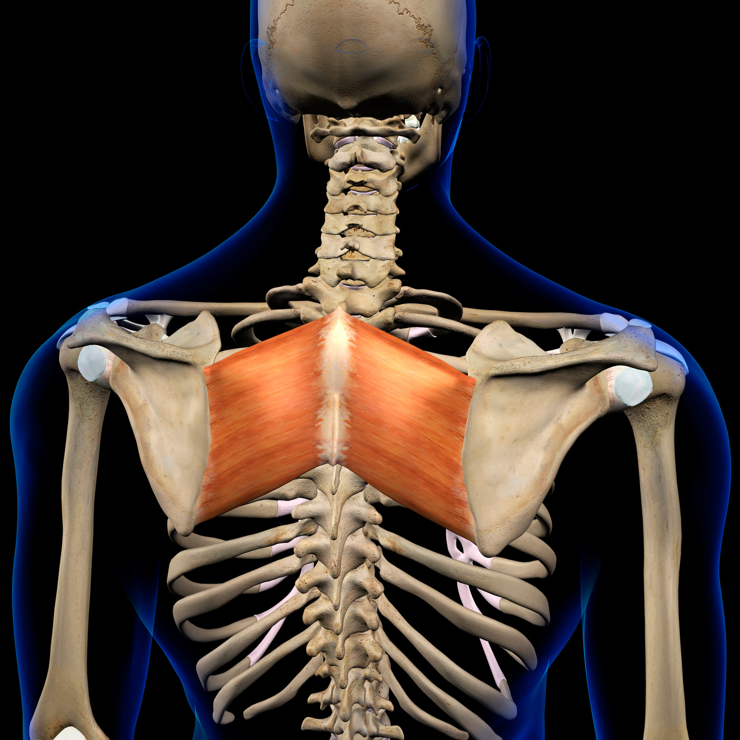


CHIROPRACTIC MEDICINE
CURRENT
13 Slots
Filled Slots
Cleveland Chiropractic College
(Kansas City, MO)
1
5
Life University (Marietta, GA)
2
2
Logan College of Chiropractic (Chesterfield, MO)
3
6
Palmer College of Chiropractic (Davenport, IA)
2
3
Parker College of Chiropractic (Irving, TX)
5
6
Total
13
Total across the 4 year program
52
22

Slide 78
Agenda Item No. 19
Policy Amendment: Arkansas Future Grant Program
Amendments as a result of Act 413 of 2023
No known opposition
No anticipated fiscal impact
Substantive changes include:
  Removal and clarification of eligibility program requirements
  Addition of language regarding summer semester eligibility

Slide 79
Agenda Item No. 20
Policy Amendment: Governor’s Higher Education Transition Scholarship Program
Amendments as a result of Act 413 of 2023
No known opposition
No anticipated fiscal impact
Substantive changes include:
  Removal and clarification of eligibility program requirements
  Addition of language regarding summer semester eligibility

Slide 80
Agenda Item No. 21
Policy Amendment: Concurrent Challenge Scholarship Program
Amendments as a result of Acts 413, 386, and 539 of 2023
No known opposition
No anticipated fiscal impact
Substantive changes include:
  Addition of high school sophomore eligibility
  Removal and clarification of vocational technical schools
  Addition of language regarding summer semester eligibility

Slide 81
Agenda Item No. 22
Policy Amendment: Governor’s Scholars Program
Amendments as a result of Acts 413 of 2023
No known opposition
No anticipated fiscal impact
Substantive changes include:
  Addition of language regarding summer semester eligibility

Slide 82
Agenda Item No. 23
Policy Amendment: Arkansas Workforce Challenge Scholarship Program
Amendments as a result of Acts 413 and 539 of 2023
No known opposition
No anticipated fiscal impact
Substantive changes include:
  Addition of vocational technical schools
  Addition of language regarding summer semester eligibility

Slide 83
Agenda Item No. 24
Policy Amendment: Arkansas Teacher Academy Challenge Scholarship Program
Creation as a result of Acts 237 of 2023
No known opposition
$12 million anticipated fiscal impact
Substantive changes include:
  Allows aspiring teacher to receive a scholarship for tuition and fees for bachelor and master degrees in teaching
  The requirement is a 1:1 ratio where awardees must teach in an Arkansas public school for each year they receive the funds

Slide 84
Agenda Item No. 25
Policy Amendment: Productivity Funding Distribution Policy
Amendment due to recommendation from Funding Workgroup
No known opposition
No anticipated fiscal impact
Substantive changes include:
  Change in language reflecting institutional stop loss

Slide 85
FINANCE COMMITTEE REPORT

Slide 86
ACADEMIC COMMITTEE REPORT

Slide 87
ANY QUESTIONS?

Slide 88
PUBLIC COMMENTS/
ANNOUNCEMENTS
Follow-up questions can be sent to: Nichole.Abernathy@adhe.edu
Presentations will be posted on the ADHE website at:
https://www.adhe.edu/about-adhe/coordinating-board/board-presentations

